Slide 1
KOTLIN BASIC CONCEPTS

Slide 2
Kotlin Topics
Kotlin Basics
Comments
Variables
Datatypes
Operators
Type Conversions
Standard Input/Output
Control Flow
If – else
When
While
Break, Continue
For loop
Ranges
Arrays
Null Safety

Slide 3
Kotlin Topics
Functions
Recursion and Tail Recursion
Lambdas and Anonymous
Inline, Infix, Higher order
OOPs Concepts
Classes/Objects
Nested and Getter, Setter
Constructors
Modifiers
Inheritance
Interfaces
Abstract
Data, Sealed Classes
Enum , Extension Function
Serialization and Deserialization

Slide 4
Kotlin Topics
Coroutines Basics
Packages and Imports
Error Handling
Kotlin Standard Library
Interoperability

Slide 5
Android Topics

Slide 6
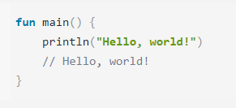
Simple Program

Slide 7
Explanation
The body of a function is written within curly braces {}
println()and print() functions print their arguments to standard output.
fun is used to declare a function.
The main() function is where your program starts from.

Slide 8
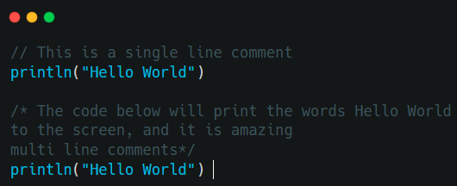
Comments
Single-line Comments
Multi-line Comments

Slide 9
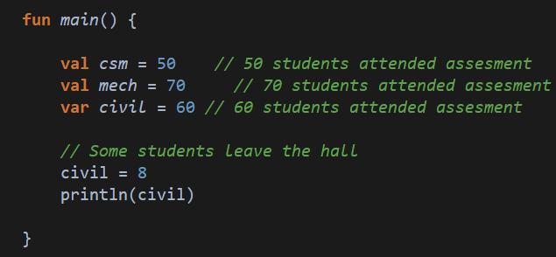
Variables - These help us to store data.
Read-only variables with val
Mutable variables with var

Slide 10
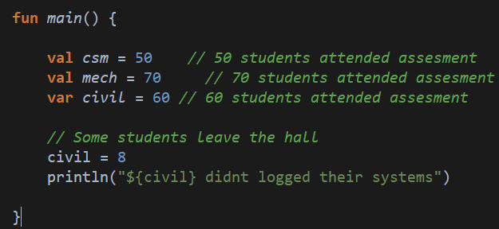
Contd..
String templates
Template expressions to access data stored in variables and other objects, and convert them into strings.

Slide 11
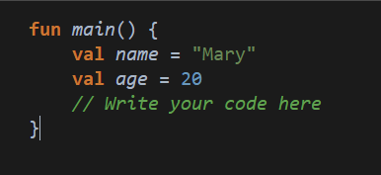
Output ?
"Mary is 20 years old"

Slide 12
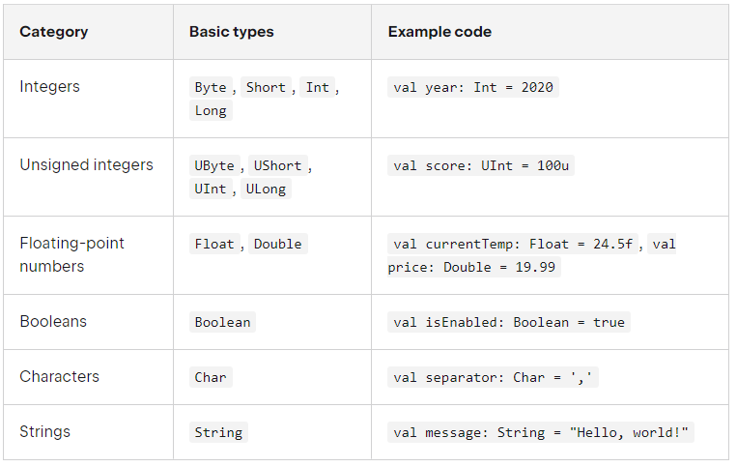
Basic Types

Slide 13
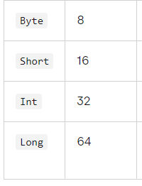
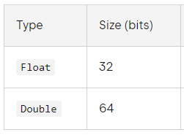
Numbers and Unsigned
Integer types
Floating-point types﻿

Slide 14
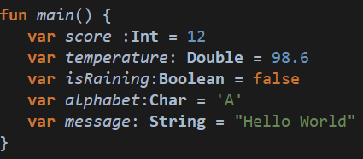
Snippet - Datatypes

Slide 15
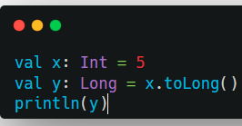
Type Conversion
To convert a numeric data type to another type, you must use one of the following functions: toByte(), toShort(), toInt(), toLong(), toFloat(), toDouble() or toChar()

Slide 16
Operators
Arithmetic operator
Relation operator
Assignment operator
Unary operator
Logical operator

Slide 17
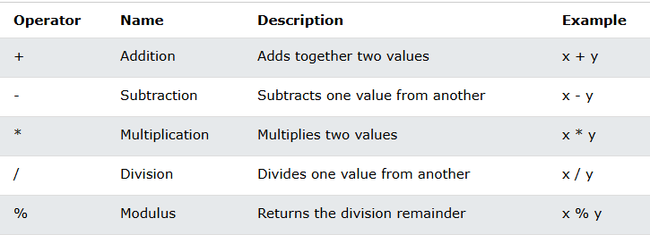
Arithmetic

Slide 18
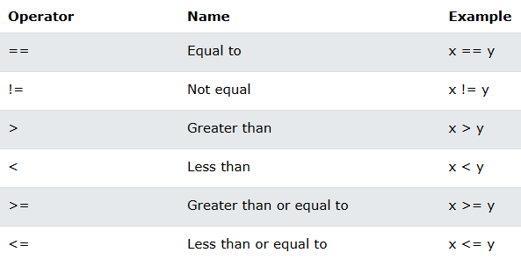
Relation or Comparison Operators

Slide 19
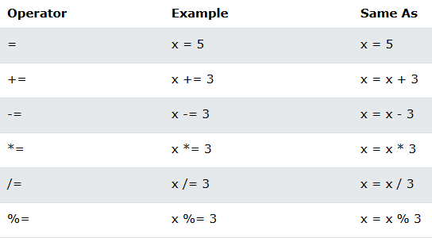
Assignment

Slide 20
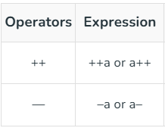
Unary

Slide 21
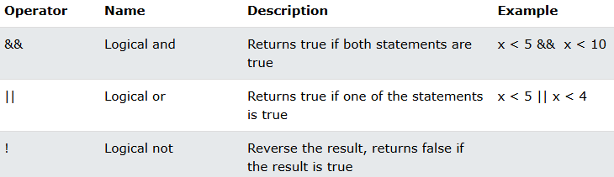
Logical Operators

Slide 22
Standard Input/Output
Kotlin output –
print() function
println() function
Kotlin input –
readline() method
Scanner class

Slide 23
Control Flow
Conditional expressions
If – else
if expression
if-else expression
if-else-if ladder expression
nested if expression
Loops
For
Range
Array
String
Collection
While, do-while
When

Slide 24
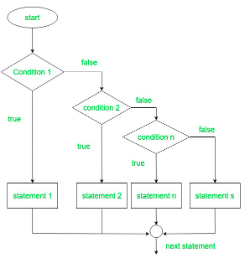
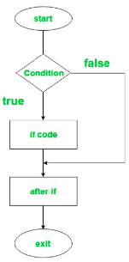
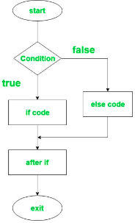
If – else

Slide 25
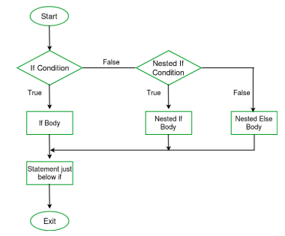
Nested if- else

Slide 26
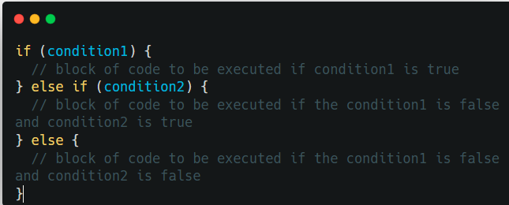
If - else

Slide 27
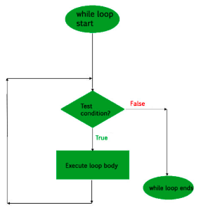
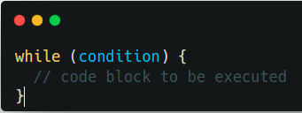
While

Slide 28
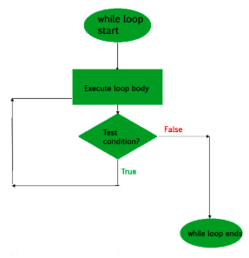
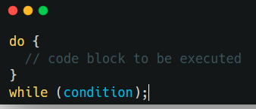
do-While

Slide 29
When
The when expression is similar to the switch statement in Java

Slide 30
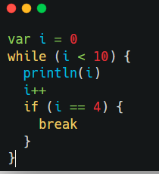
Break and continue
The break statement is used to jump out of a loop.
Labelled Break
Unlabelled Break

Slide 31
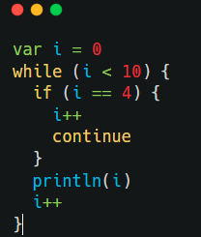
Continue
The continue statement breaks one iteration (in the loop), if a specified condition occurs, and continues with the next iteration in the loop.
Labelled Continue
Unlabelled Continue

Slide 32
For with Range
For loop is used to loop through arrays, ranges, and other things that contains a countable number of values.
For Loop through Int array and string array.
Use of break and continue keywords in a range/for loop

Slide 33
For with Array
Arrays are used to store multiple values in a single variable, instead of creating separate variables for each value.
Print the array elements
Printing the array and index
Print particular index
Set array value
Get the size of array
Outofbound Exception

Slide 34
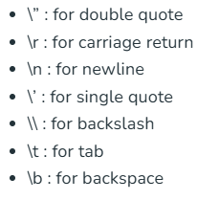
String
Syntax
Creating an empty String
access the elements of a string
properties and functions in String
String Literals
String Equality

Slide 35
Collections
Lists – Ordered collections of elements that allow duplicates.
Sets – Unordered collections of unique elements.
Maps – Collections of key-value pairs, where each key is unique.
Arrays – Fixed-size collections of elements with a specific type.
Sequences – Lazily evaluated collections of elements that can be processed in a pipeline.

Slide 36
Collections
Immutable Collection – Can not be modified
List – listOf() and listOf<T>()
Set – setOf()
Map – mapOf()
Mutable Collection – Supports read & write
List – mutableListOf(),arrayListOf() and ArrayList
Set – mutableSetOf(), hashSetOf()
Map – mutableMapOf(), hashMapOf() and HashMap

Slide 37
Syntax
like arrays, they have [] accessors, iterators, set, get operations
like the java ArrayList, lists are dynamic sized
val list1: List<Int> = LinkedList<Int>() //linked list implementation
val list2: List<Int> = ArrayList<Int>()

Slide 38
initializers.
val a = arrayOf(1, 2, 3)
a[0] = a[1] // OK
val l = listOf(1, 2, 3) //immutable
l[0] = l[1] // doesn't compile
val m = mutableListOf(1, 2, 3)
m[0] = m[1] // OK
m.add(4)
println(l.size) // 4

Slide 39
Null safety

Slide 40
Null safety
In some languages, a reference type variable can be declared without providing an initial explicit value.
In these cases, the variables usually contain a null value.
Kotlin variables can't hold null values by default. This means that the following snippet is invalid:
// Fails to compile
val languageName: String = null

Slide 41
Null Safety
For a variable to hold a null value, it must be of a nullable type. You can specify a variable as being nullable by suffixing its type with ?, as shown in the following example:
val languageName: String? = null
With a String? type, you can assign either a String value or null to languageName.

Slide 42
Null safety
You must handle nullable variables carefully or risk a dreaded NullPointerException. In Java, for example, if you attempt to invoke a method on a null value, your program crashes.
Kotlin provides several mechanisms for safely working with nullable variables.

Slide 43
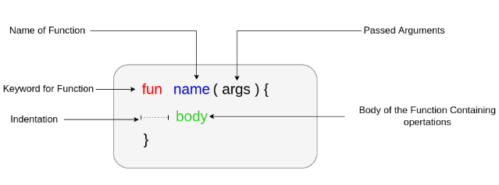
Functions
User-defined function
Standard library function

Slide 44
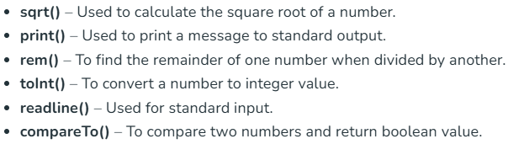
Standard library Functions

Slide 45
Objects and Classes
class className { // class header
// property
// member function
}
Class name: every class has a specific name
Class header: header consists of parameters and constructors of a class
Class body: surrounded by curly braces, contains member functions and other property.

Slide 46
Abstract class
In Kotlin, an abstract class is a class that cannot be instantiated and is meant to be subclassed.
An abstract class may contain both abstract methods (methods without a body) and concrete methods (methods with a body).
An abstract class is used to provide a common interface and implementation for its subclasses.
When a subclass extends an abstract class, it must provide implementations for all of the abstract methods defined in the abstract class.

Slide 47
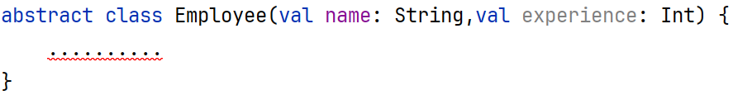
Abstract class
In Kotlin, an abstract class is declared using the abstract keyword in front of the class.
An abstract class can not instantiate means we can not create object for the abstract class.

Slide 48
Important points – Abstract Class
We can’t create an object for abstract class.
All the variables (properties) and member functions of an abstract class are by default non-abstract. So, if we want to override these members in the child class then we need to use open keyword.
If we declare a member function as abstract then we does not need to annotate with open keyword because these are open by default.
An abstract member function doesn’t have a body, and it must be implemented in the derived class.

Slide 49
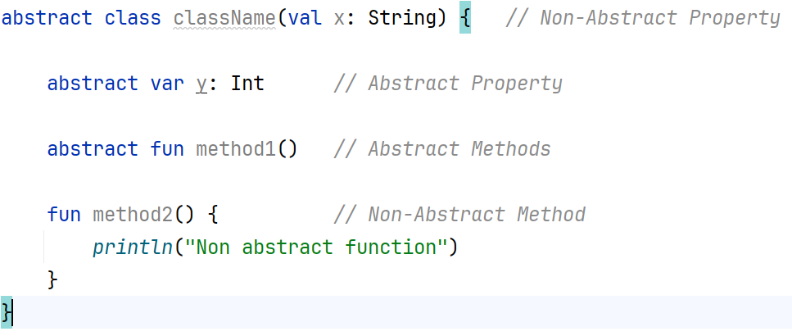

Slide 50
Advantages
Abstraction: Abstract classes provide a way to define a common contract between different classes without specifying the implementation details. This enables you to create abstractions that improve the modularity and maintainability of your code.
Polymorphism: Abstract classes allow you to create objects of different types that have the same interface, which enables polymorphic behavior.

Slide 51
Advantages
Code Reusability: Abstract classes provide a way to reuse code by allowing multiple classes to extend the same abstract class and share the same abstract methods and properties.
Implementing Common Behavior: Abstract classes provide a way to implement common behavior for its subclasses, reducing the amount of code that needs to be written in each subclass.

Slide 52
Disadvantages
Limited Instantiation: Abstract classes cannot be instantiated, so they provide limited instantiation details.
Complexity: Abstract classes can make your code more complex, especially if you have many classes that extend multiple abstract classes.

Slide 53
Interfaces
In Kotlin, an interface is a collection of abstract methods and properties that define a common contract for classes that implement the interface.
An interface is similar to an abstract class, but it can be implemented by multiple classes, and it cannot have state.
With the interface, you can define a set of properties and methods, that the concrete types must follow and implement.

Slide 54
Creating interfaces
The interface definition in Kotlin begins with the interface keyword followed by the name of the interface, followed by the curly braces within which the members of the interface reside.
The difference is that the members will have no definition of their own. These definitions will be provided by the conforming types.

Slide 55
Implementing Interfaces
An interface can be implemented by a class or an object. When implementing an interface, the conforming type must provide the definition for all of its members.
To implement an interface, the name of the custom type is followed by a colon and the name of the interface which is to be implemented.

Slide 58
Constructor
class className constructor(parameters) {
// property
// member function
}

Slide 59
Contd..
Create an object
var obj = className()
Accessing the property of the class:
obj.nameOfProperty
Accessing the member function of the class:
obj.funtionName(parameters)

Slide 60
functions
basics:
fun name([ parameters,]): ReturnType {
statements
return Type
}
parameters are optional and so is the return

Slide 61
fun generateAnswerString(countThreshold: Int): String { val answerString = if (count > countThreshold) { "I have the answer." } else { "The answer eludes me." } return answerString }
fun generateAnswerString(countThreshold: Int): String = if (count > countThreshold) { "I have the answer" } else { "The answer eludes me" }

Slide 62
functions (2)
anonymous functions
We'll see a lot of anonymous functions in android.
val stringLengthFunc: (String) -> Int = { input ->
input.length
}

Slide 63
stringLengthFunc contains a reference to an anonymous function that takes a String as input and returns the length of the input String as output of type Int. For that reason, the function's type is denoted as (String) -> Int.
calling the above function is the same
val stringLength: Int = stringLengthFunc("Android")

Slide 64
functions (3)
higher-order functions, ie functions that take functions as parameters
In java, this would be a way to use the callback interface.
fun stringMapper(str: String, mapper: (String) -> Int): Int {
// Invoke function
return mapper(str)
}

Slide 65
functions (3)
val name = stringMapper("Android", { input ->
input.length
})

Slide 66
class
simple version with no constructor.
class <name> {
variables
functions
}
Note, there is not a "new" keyword.
example:
class Car {
val wheels = ArrayList<Wheel>()
//public and Wheel is another class.
private val doorLock: Int = 12
fun unlockDoor(key: Int): Boolean {
return key == doorLock
}
}
fun main() {
val car = Car() // construct a Car
val wheels = car.wheels
// retrieve the wheels value from the Car
}

Slide 67
class (2)
constructors
class Car (val wheels: List<Wheel>) { //note it's declared here.
private val doorLock: Int = 12
fun unlockDoor(key: Int): Boolean {
return key == doorLock
}
}
val car = Car(ArrayList<Wheel>())

Slide 68
class (3)
constructors
class Car (val wheels: List<Wheel>) { //note it's declared here.
private val doorLock: Int = 12
private var numWheels : int =0
fun unlockDoor(key: Int): Boolean {
return key == doorLock
}
init { //this more like a classic java no parameter constructor.
numWheels = wheels.size //use init to setup any local variables
}
}
val car = Car(ArrayList<Wheel>())

Slide 69
class members
Constructors and initializer blocks
Functions
Properties
Nested and Inner Classes
Object Declarations
Companion classes and variables.
Think static keyword in java.
All classes in Kotlin have a common superclass Any, that is the default superclass for a class with no supertypes declared:
class Example // Implicitly inherits from Any
Any has three methods: equals(), hashCode() and toString(). Thus, they are defined for all Kotlin classes.

Slide 70
inheritance
by default, all Kotlin classes are final (ie can't be inherited)
open class Base //class can now be inherited
to inherit (no constructor)
open class Base()
class Derived(): Base()
with constructors
open class Base(p: Int)
class Derived(p: Int): Base(p)
note a primary constructor must be initialized here.

Slide 71
inheritance (2): Overriding Methods
things must be explicit in Kotlin. explicit modifiers for overridable members and for overrides:
open class Shape {
open fun draw() { /*...*/ }
fun fill() { /*...*/ }
}
class Circle() : Shape() {
override fun draw() { /*...*/ }
}
But fill() can not be overridden.

Slide 72
inheritance (2): Overriding variables.
open class Shape {
open val vertexCount: Int = 0 //set to zero, immutable
}
class Rectangle : Shape() {
override val vertexCount = 4 //set to 4, immutable
}
class Polygon : Shape (){
override var vertexCount: Int = 0 // Can be set to any number later
}

Slide 73
Interoperability
One of Kotlin’s most important features is its fluid interoperability with Java. Because Kotlin code compiles down to JVM bytecode, your Kotlin code can call directly into Java code and vice-versa. This means that you can leverage existing Java libraries directly from Kotlin. Furthermore, the majority of Android APIs are written in Java, and you can call them directly from Kotlin.
https://developer.android.com/kotlin/learn#interoperability
But it doesn't always mean there is a one-to-one relation in the language though. Java threading is very different from Kotlin threading.

